Slide 1


AI & Robotics
Mentoring for ICSE Class IX & X
Make India
an AI
Super Power
IoT, Robotics
& AI Study
nodiam, Education that enlightens!
Dependable Competency Partners
Expert Industry Veterans
Lucid & Practical
IT
Competency
Scientific
Knowledge

Slide 2

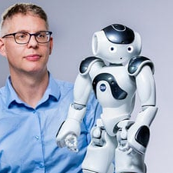

A Brave New World
Mundane Professions to Phase Out
Basic office jobs: Accountants, clerks, tellers, junior lawyers
Junior software & web dev, BPOs, telemarketing & data entry
Basic content writers, proofreaders & graphic designers
Farming, security, factory workers & assembly line
Packagers, drivers, warehousing workers, delivery workers
Experts To Need More AI Skills
Healthcare: Doctors, surgeons, therapists, technicians
Teachers & educationists
Scientists & researchers
Software developers, trade's people, technicians & artists
Corporate strategists, social workers & lawyers
Creative & Innovative Professions To Be In
Artificial intelligence & Machine learning engineers
Data engineers & data scientists
IoT specialists & robotics engineers
Senior software engineers
A.I. – more profound than fire or electricity!
- Sundar Pichai, Alphabet C.E.O.

Slide 3

nodiam’s Professional Competencies
nodiam’s mission is to mentor school children into leading edge technologies because children’s appreciation for technology today, will make India the leader of tomorrow. We are pleased to join hands with elite schools like Loreto, Elliot St. in this journey.
Our globally industry leading coaches are specialists in:
Comprehensive teaching of CICSE Robotics & AI syllabus
Python computing skills & all relevant libraries
Data Science, AI, Analytics & Data Visualization
Computer Vision & NLP
IoT & Robotics
Cyber Security
Hands-on labs & project-based mentoring
Support beyond syllabus & instil knack for career excelling
Impart awareness of ethical considerations
Accurate skill assessment of students in the above areas

Slide 4
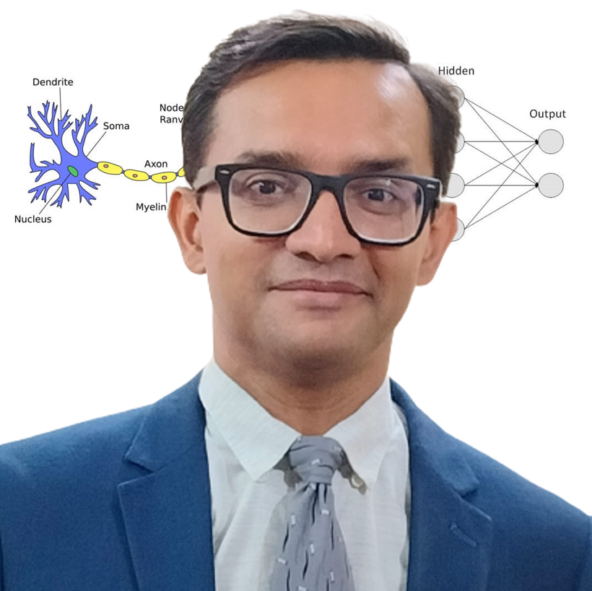
AI & Python Faculty
Empathetic, Dynamic, & Supportive
24 years of blue-chip experience
Corporate trainer & excellent communications
Dynamo of energy, dependable & trusted for the job! – Vish Coosa, Morgan Stanley, U.S.A.
Thorough Knowledge, Can Make Difficult Concepts in AI Seem Lucid
Worked on multiple Corporate AI projects globally
Elementary thinker, visualizes subject matter through clutter & noise
Improved accuracy of AI models singlehandedly up to 99.8%
Super brain, the best guy to take care of all our AI implementation! – Government Client
Anirban Chakrabarty, C.E.O.
B.E.(Electronics), M.B.A. (Finance)
anirban@anodiam.com
+91 9073 700094 / +61 470 142 229

Slide 5
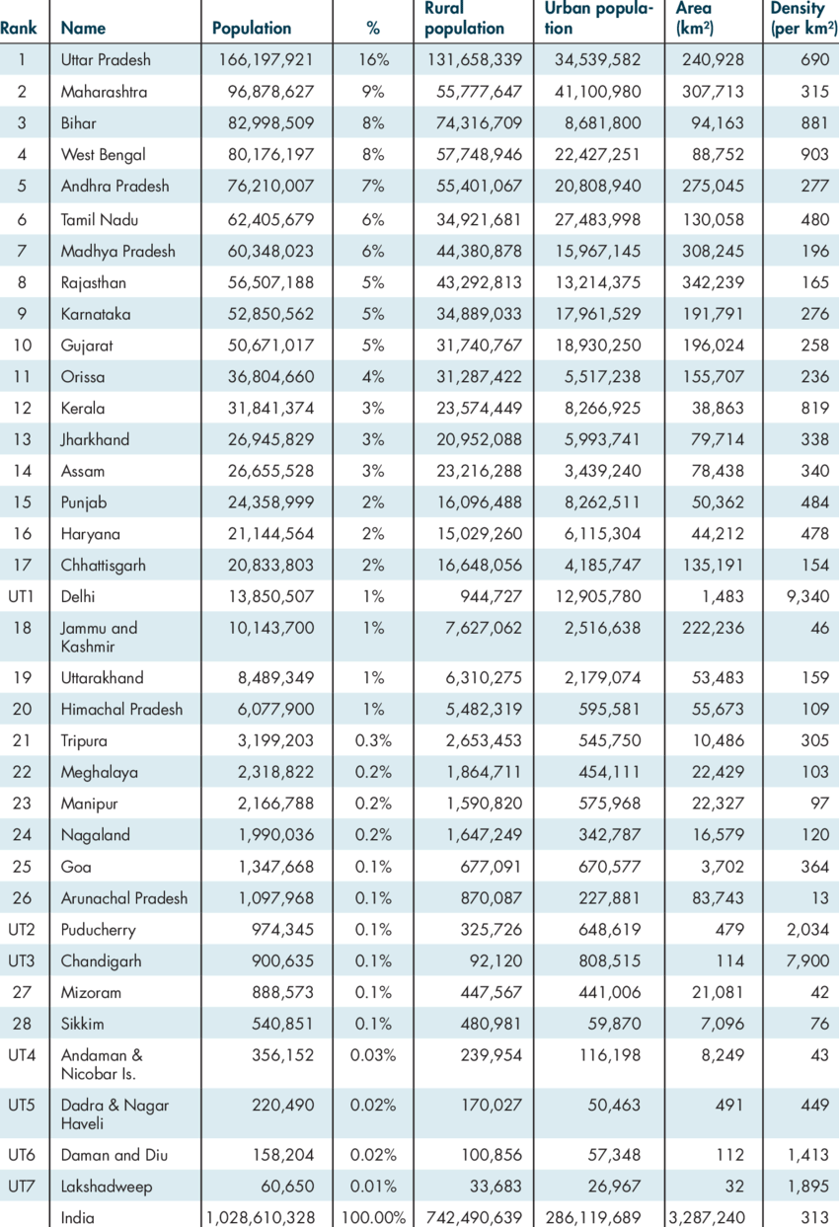
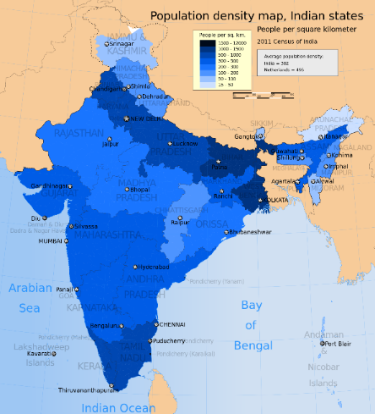

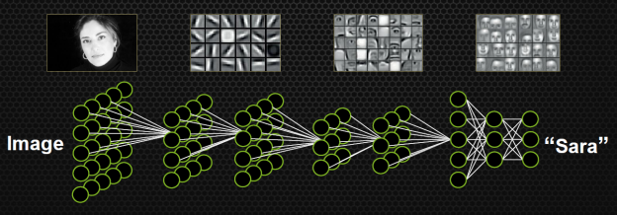
The nodiam Advantage – Python, Data Science & AI
Visualization is key
Visualize the DATA & SCIENCE of data science/AI:
Stimulates interest in otherwise dry subject
Triggers innovation through imagination
Comprehensive training resources
Relatable concepts: simplified & delightful
Empathetic & supportive teaching style
Step-by-step, holistic approach
De-clutter the thoughts & inspire to seek further
Visual demonstration of how AI actually works internally

Slide 6

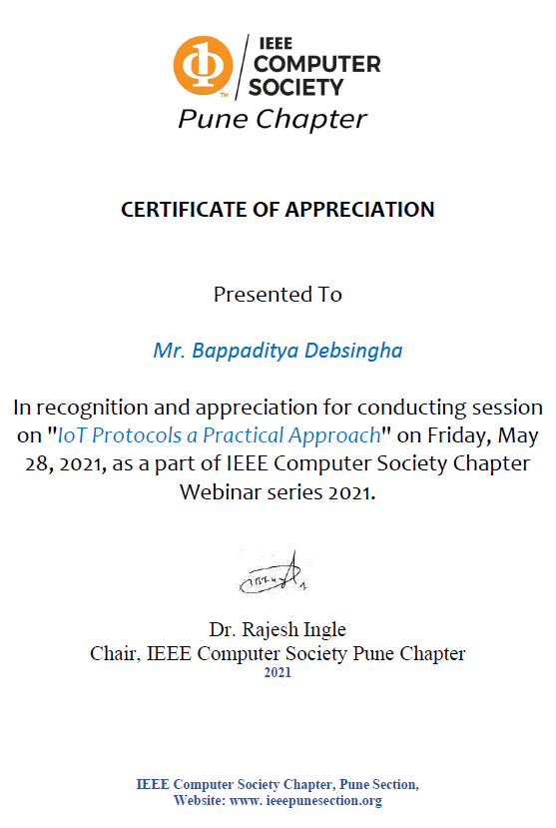
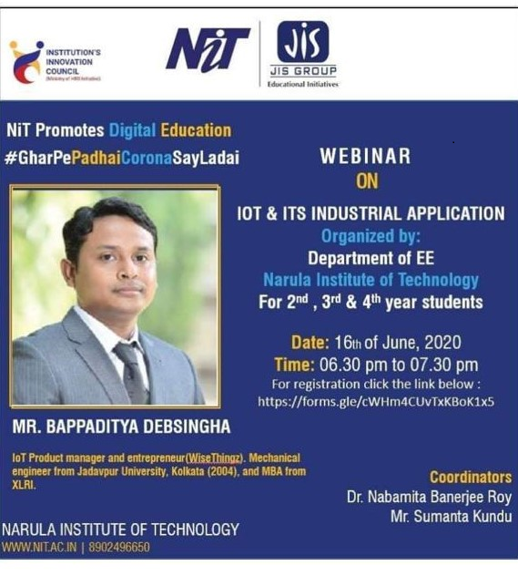
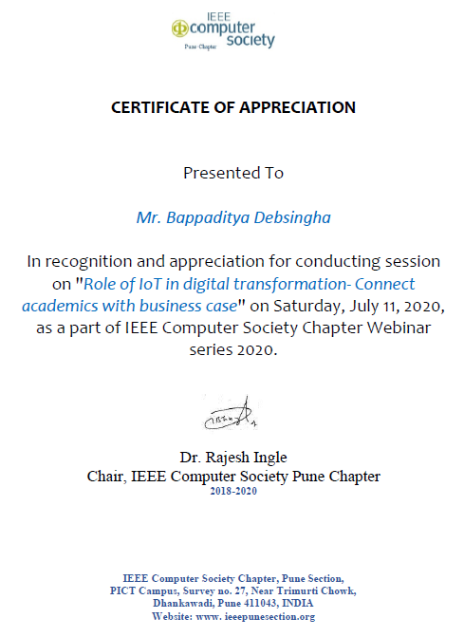
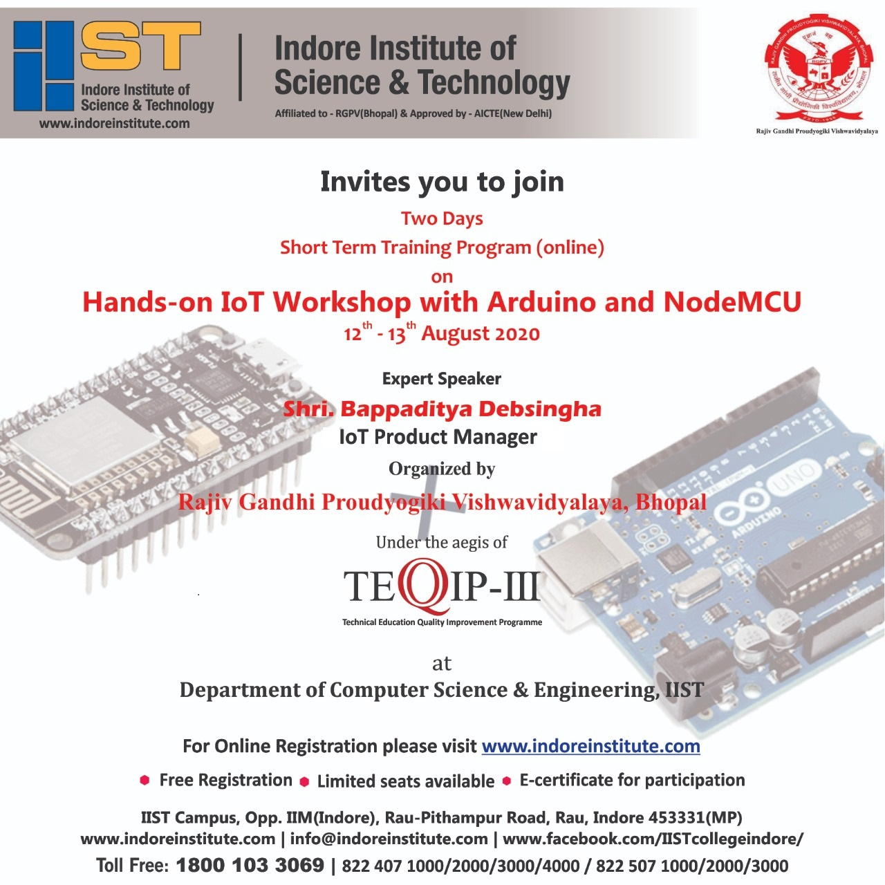
Robotics & IoT Faculty
Inspiring Mentor, Innovative & Entrepreneurial
18 years of global experience
Trained hundreds of children & industry professionals
IoT & Robotics workshops at institutions & corporates
Industry Leading S.M.E. in the fields of
Autonomous machines, automation, sensors & IoT driven BI
Analytics dashboards, Cloud API gateways, integration to mobile apps
Bappaditya Debsingha, IoT Prod Manager
B.E.(J.U., Mechanical), M.B.A.(XLRI)
https://www.youtube.com/c/wisethingz
https://www.instagram.com/bappa_wt
www.wisethingz.com

Slide 7
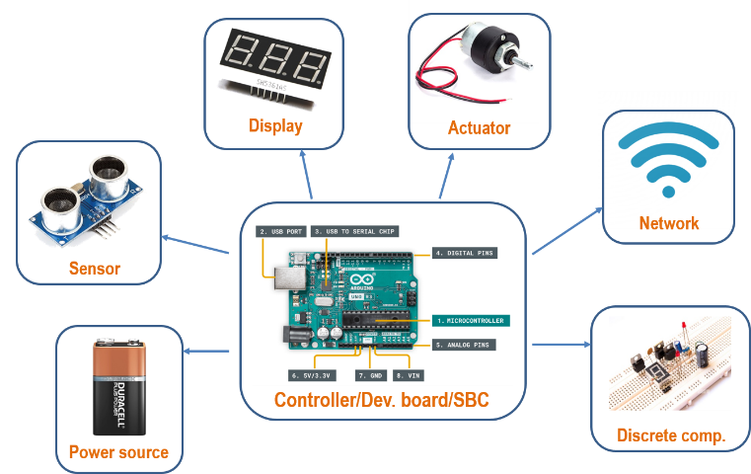
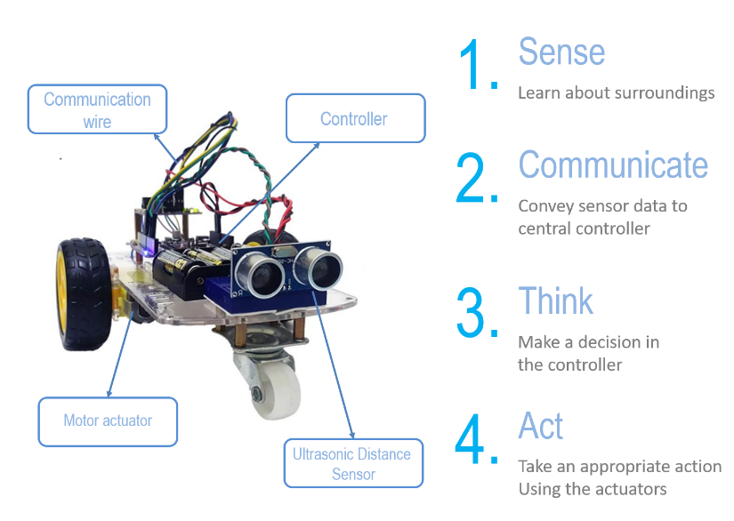
The nodiam Advantage – Robotics & IOT
At nodiam, we boast our own:
Development boards
Managed IoT cloud platform
Comprehensive training resources
Robotics Components
We inspire through hands-on projects:
Comprehensive syllabus coverage
Practical & lucid, help conceptualize
Inspire beyond curriculum to excel in career
Experiments & Projects

Slide 8
Pricing
₹5,90,000 (approx. per year per batch - 30 students ICSE, IX/X)
Lab Equipment (provided at actual price)
Less than ₹50,000 (approximately) per year per batch
Analytics & Python Programming
ICSE syllabus comprehensive coverage
₹150 per student per class, 40 classes/year
₹1,80,000 per year per batch of 30 students
40% advance, 30% after every 24 weeks
Robotics & AI including labs
ICSE syllabus comprehensive coverage
₹300 per student per class, 40 classes/year
₹3,60,000 per year per batch of 30 students
40% advance, 30% after every 24 weeks
Bulk Discounts Available Only for Loreto , Elliot St.
All costs are inclusive of GST (0%)
33% OFF
per batch after 4th batch
0% Rise in
5 Years
On upfront payment for
2 years
Thank You!

